Slide 1
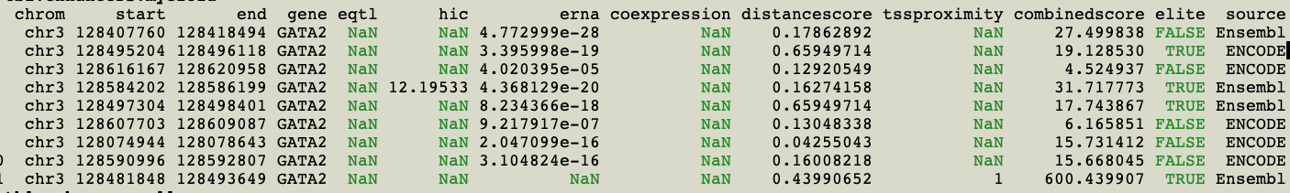
GeneHancer reports 9 regions associated with GATA2 in “Common myeloid progenitor
CD34+ cells”. Interestingly, when all 310 GeneHancer tissues are included, only 6 more regions
are added - and none of these intersect your ATAC-seq regions.
The evidence adduced for these myeloid (HSC?) regions, as you can see above,
is not as strong as we’d like. “erna” is short for “enhancer rna” and is new to me.
The 4 TBX15 enhancer/ATAC-seq motif matches
1: chr3:128,483,003-128,483,009 Hsapiens-jaspar2018-TBX15-MA0803.1 chr3 + 6.642737 0.8767398 AGGGGTGA
2: chr3:128,483,452-128,483,457 Hsapiens-jaspar2018-TBX15-MA0803.1 chr3 + 6.658030 0.8787582 CGGTGTGA
3: chr3:128,486,956-128,486,962 Hsapiens-jaspar2018-TBX15-MA0803.1 chr3 + 6.658030 0.8787582 CGGTGTGA
4: chr3:128,497,528-128,497,534 Hsapiens-jaspar2018-TBX15-MA0803.1 chr3 + 6.658030 0.8787582 CGGTGTGA

Slide 2
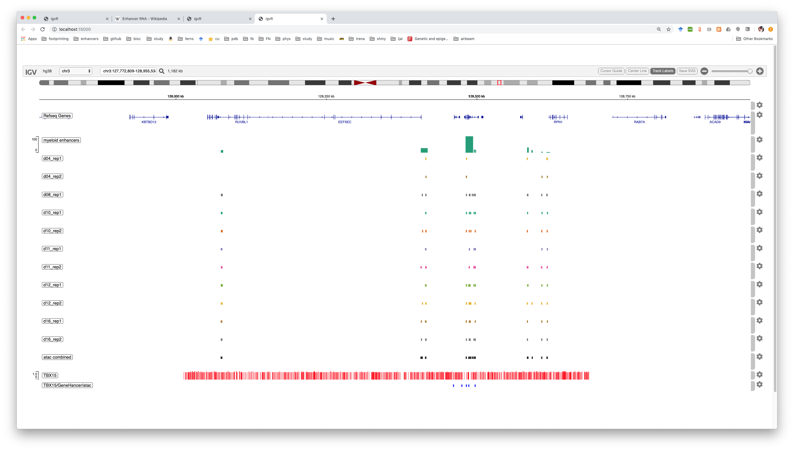
Here are all myeloid enhancers, the intersecting ATAC-seq regions
at each timepoints, all TBX15 motif matches > 85%, and finally, in blue, the
TBX15 motif hits in ATAC-seq in enhancers

Slide 3
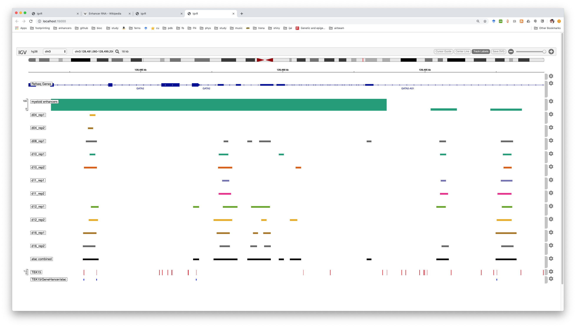
A closer look: 4 TBX15 motif matches in (or very near) GATA2

Slide 4
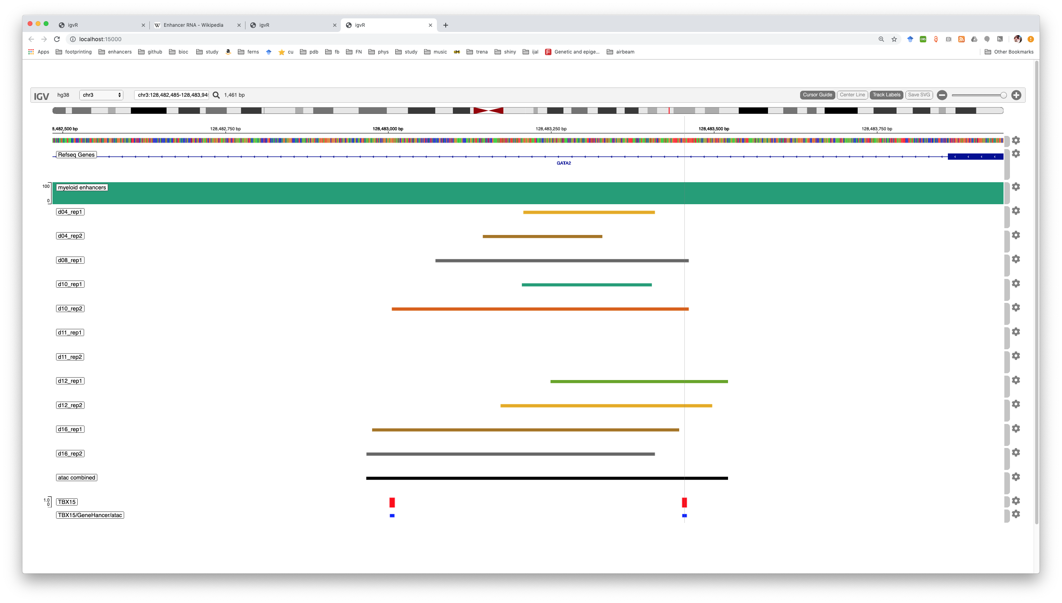
The leftmost binding sites, #1 and #2. If we take the ATAC-seq
regions at face value, there is no chance for TBX15 to bind till day 12
(but maybe the slight intersection of the motif at day8 and 10 is meaningful)

Slide 5
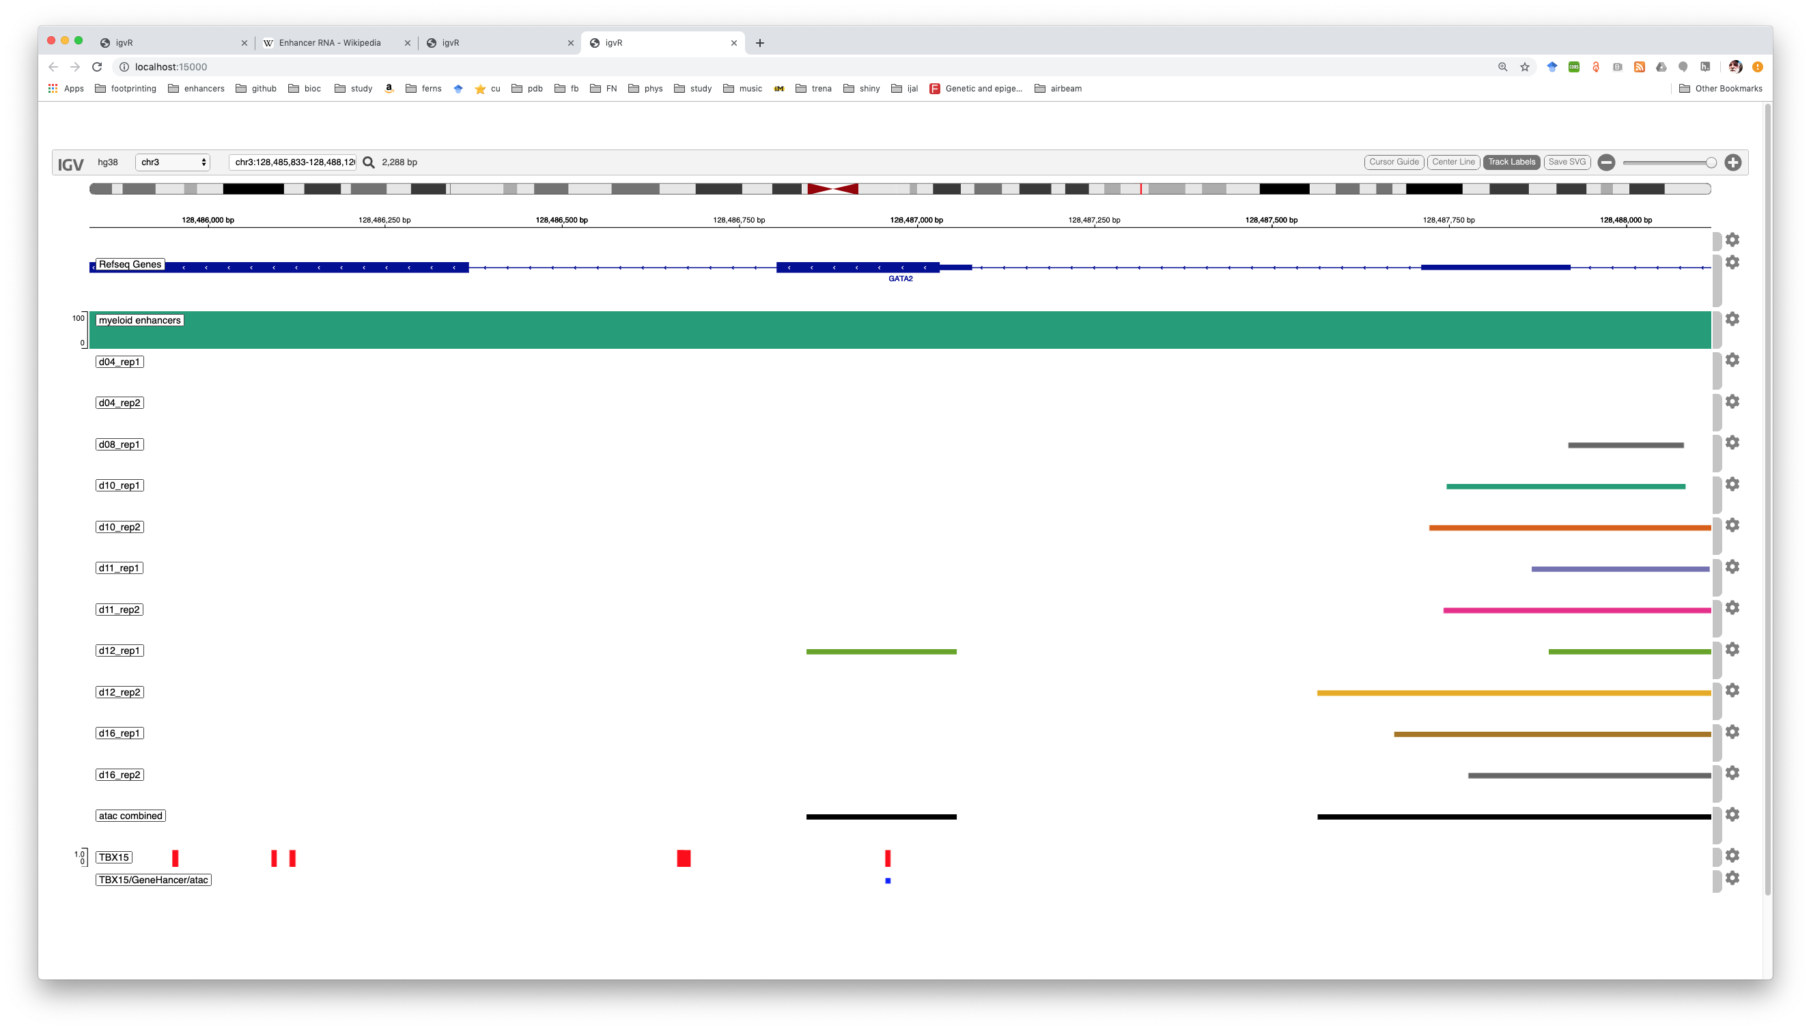
TBX binding site #3. Right in the middle of (only) a d12 rep1 ATAC-seq region

Slide 6
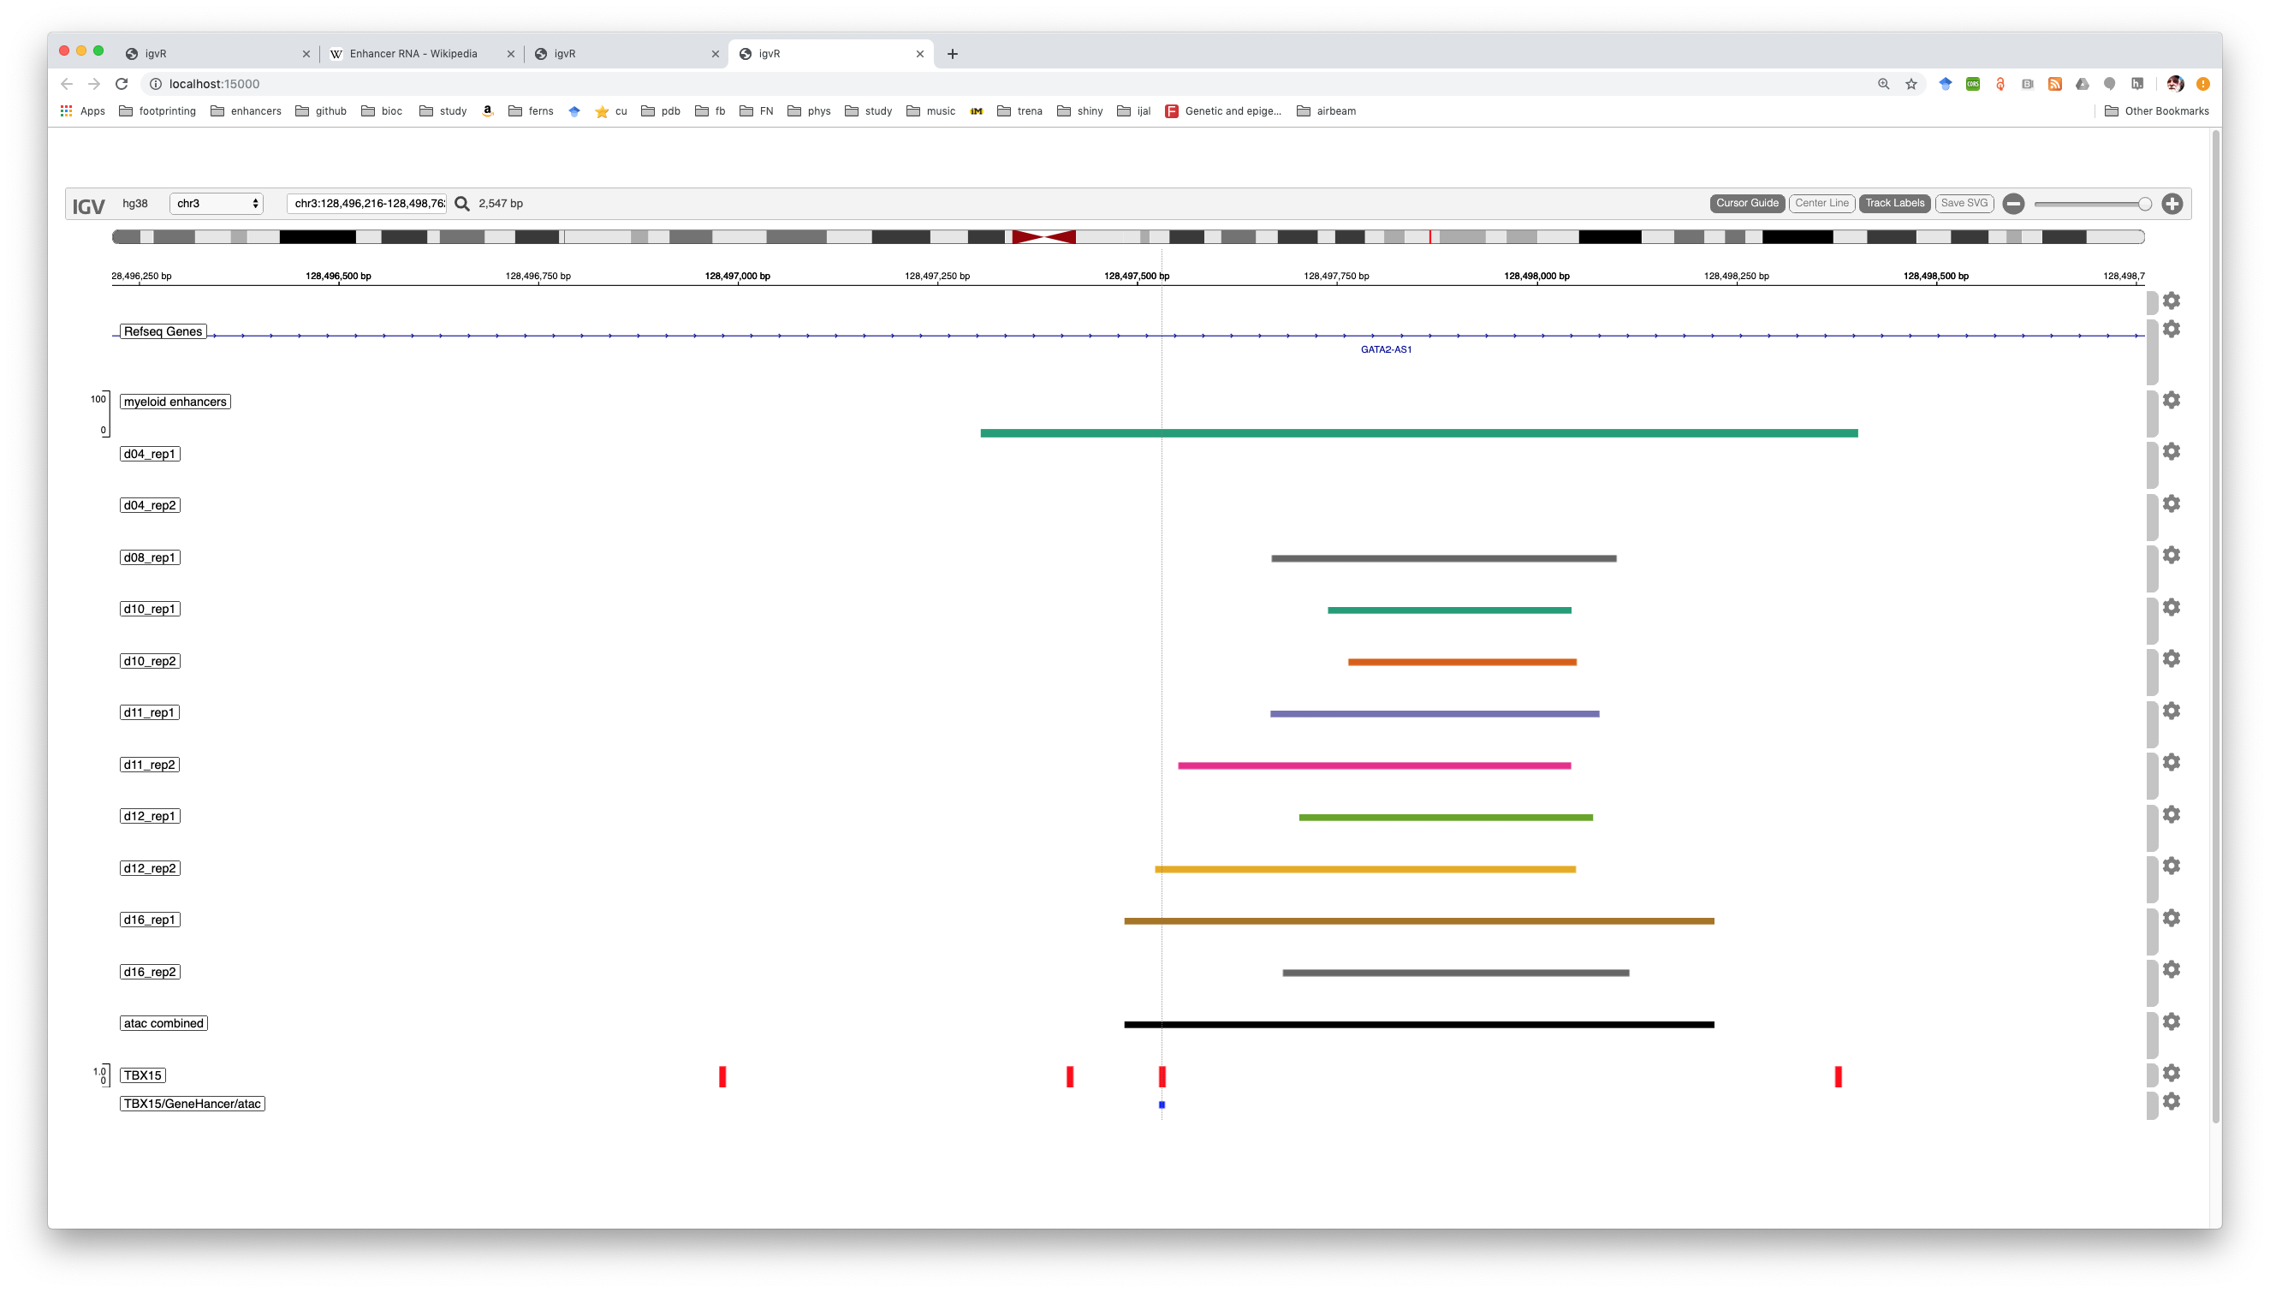
TBX15 binding site #4: no open chromatin at day 4, and a strict interpretation
of the ATAC-seq regions implies no binding possible until day 12.

Slide 7
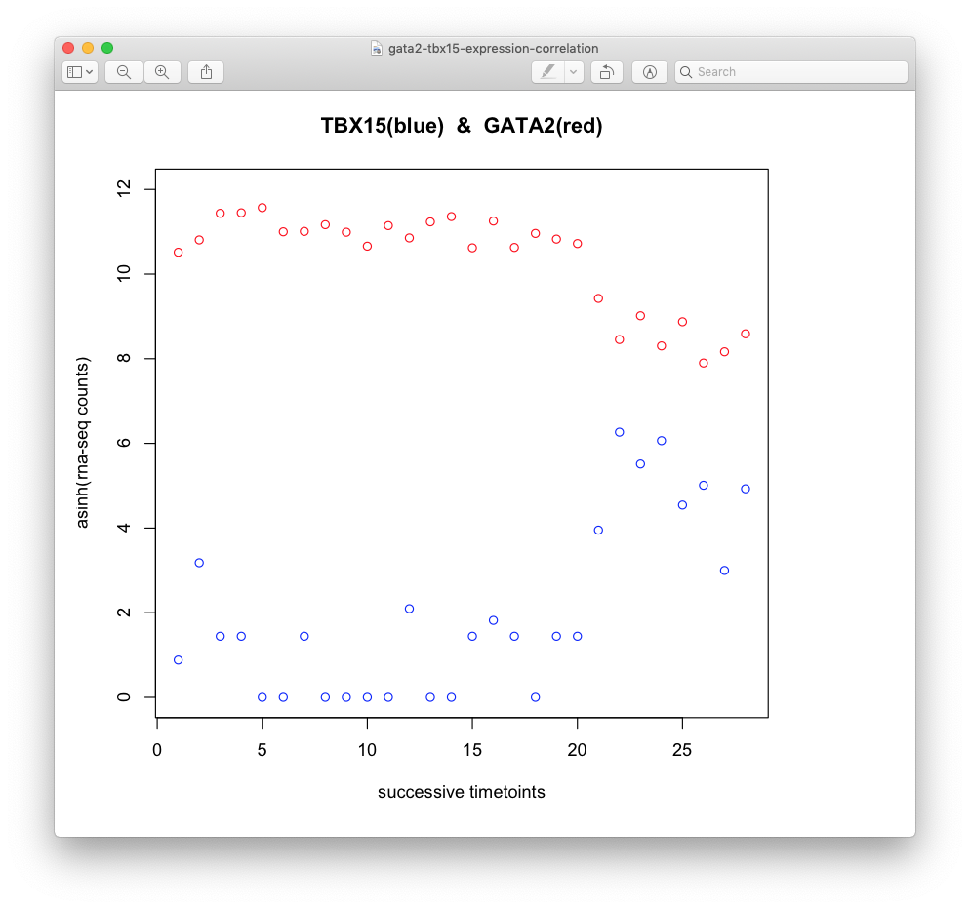
Apologies for the x-axis: I will redo this with day numbers and stage

